Slide 1
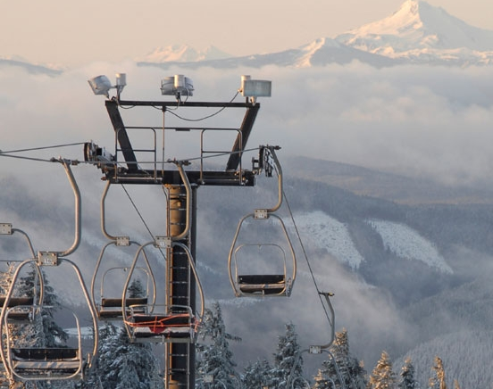
PRICING MODEL AND INCREMENTAL OPERATING COSTS
MAY 2021

Slide 2
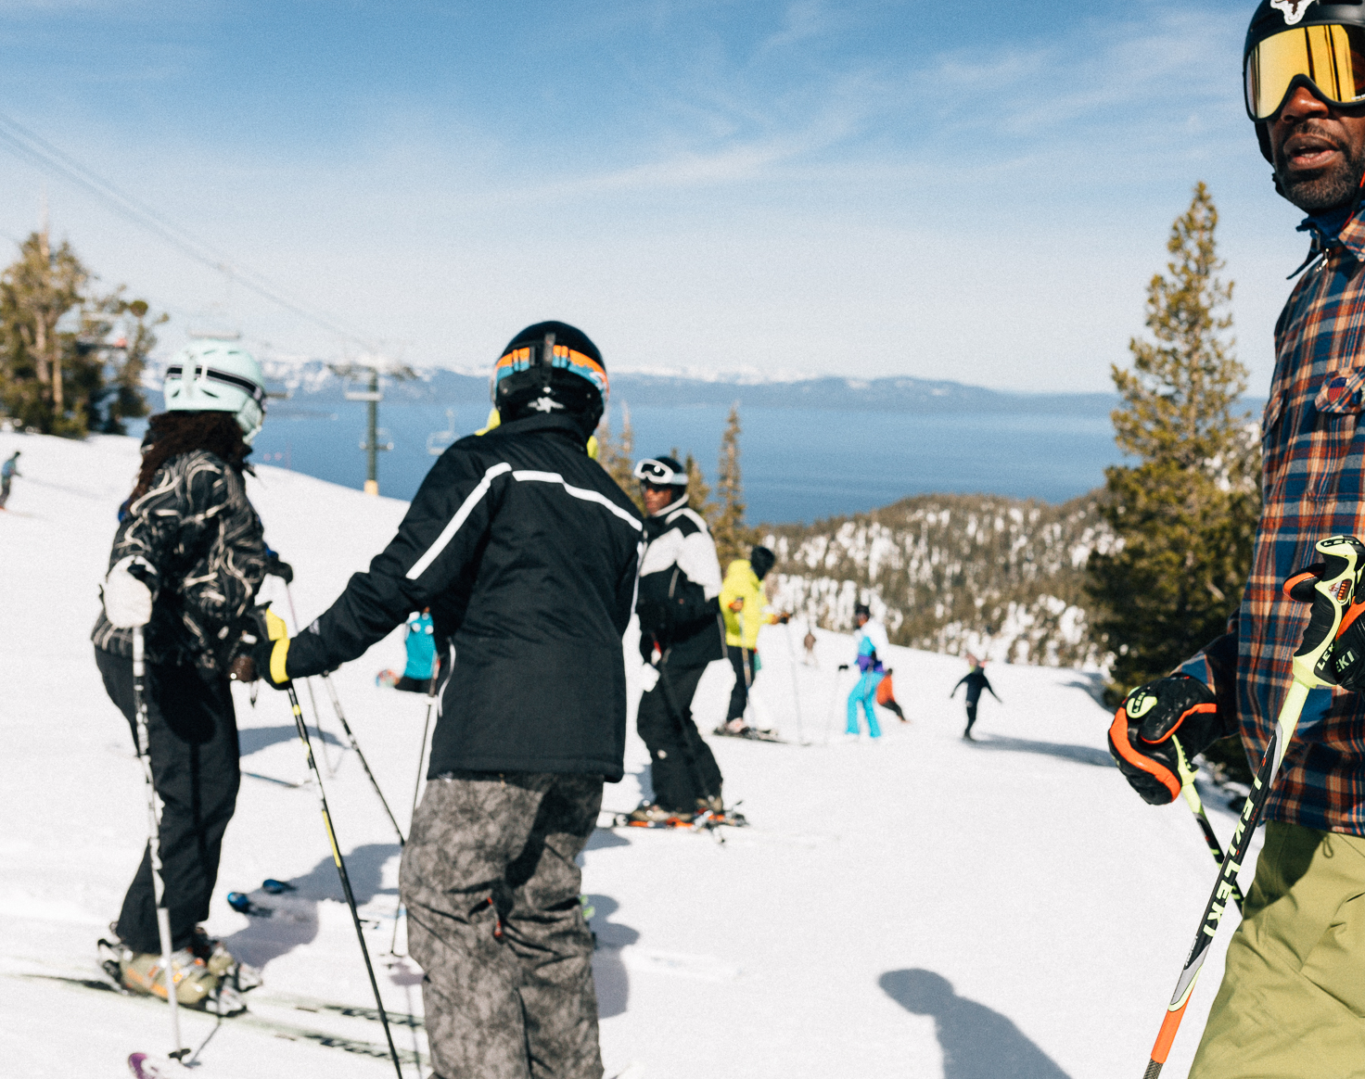
BRIEF BACKGROUND
Big Mountain Resort delivers one of the best skiing and snowboarding experiences in the country
Nuanced pricing models are key for pricing in added value and managing costs
Recent investments have substantially increased annual operating costs (+$1.5M)

Slide 3
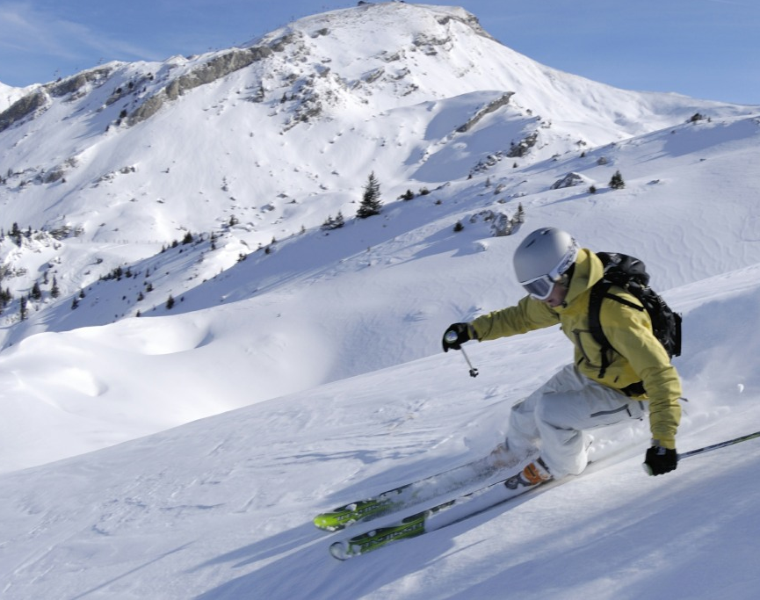
KEY FINDINGS AND RECOMMENDATIONS
Elements of the skiing experience help drive price: # of fast quads, # of runs, snow-making equipment coverage, & vertical drop drive ticket prices
Big Mountain’s features and price currently are on the high end of resorts nationwide
High level recommendations
Raise price to a level to cover $1.5m in additional operating costs
Pursue investment scenario 2: an additional run, 150 ft in vertical drop, and chair lift. Amounts to ~$2 increase in ticket price and $3.5M in revenue (factor in cost)

Slide 4
HOW DOES BIG MOUNTAIN’S TICKET PRICE COMPARE TO OTHER RESORTS?
Given that Big Mountain is already on the higher end in terms of pricing, we should be prudent in
determining how much to increase prices.

Slide 5
MODEL AND PERFORMANCE METRICS
We employed a Random Forest model; the top features we noted earlier can be seen in the visual
Using cross validation our model showed average R-squared of ~ .7 (the closer to 1 the better)

Slide 6
BIG MOUNTAIN’S POSITION IN KEY DRIVERS

Slide 7
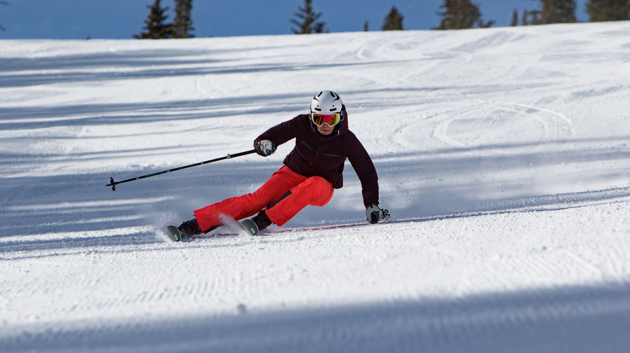
NEXT STEPS
Make model findings, specifically the scenario analysis, available in an interactive format to allow the team to iterate the ticket price support and revenue impact associated with various tactics/investments
Seek out additional cost data to painta more complete picture
Engage business leaders to determine what potential pricing constraints may exist

